Slide 1


SOFTWARE DESIGN PATTERNS
An Introduction to Design Patterns
Catalogue Number

Slide 2

Objectives
What we will learn today:
Understand what is a design pattern
Why are design patterns important
How design patterns evolved
Types of software design patterns
Anti-Patterns
Best Practices

Slide 3

Introduction – Software Design Patterns
Reusable solution to a common problem that occurs within a particular context in software design.
Proven, generalized solution to commonly recurring software design problems.
Use them as guides to make design decisions more consistent and efficient.
Design patterns are not code but concepts that can be implemented in any programming language.
It is a template to solve problems in a specific context.
Provide a standardized way to organize code and make it easier for developers to communicate ideas, improve code readability, and ensure the software is scalable and maintainable.
Think smarter, not harder—reuse proven patterns!

Slide 4










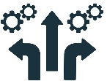
Why are Design Patterns Important?
Reusability of Solutions
Instead of reinventing the wheel, developers can use these tried-and-tested solutions to address recurring challenges efficiently.
Improved Code Maintainability and Readability
Promotes code that is well-organized and easy to understand.
Ensuring Scalability of Software
Helps structure the code so that it can handle future growth without becoming unmanageable.
Facilitates Better Communication Among Developers
Provides a common language that all developers can understand.
Increases Development Efficiency
Using well-known patterns helps developers write code faster and with fewer bugs.
Promotes Best Practices and High- Quality Code
Encourages the adoption of best practices in software development by promoting principles like: Encapsulation, Loose coupling, Separation of concerns.
Reduces the Risk of Errors and Bugs
Based on well-established solutions, they help reduce the risk of introducing bugs.
Helps with Onboarding New Developers
familiar design patterns, it becomes easier for new team members to get up to speed.
Encourages Code Flexibility & Extensibility
emphasize flexibility, making it easier to change or extend the software without breaking the existing code.
Provides Solutions Across Languages and Frameworks
language-agnostic concepts, meaning they can be applied in any programming language or framework.

Slide 5
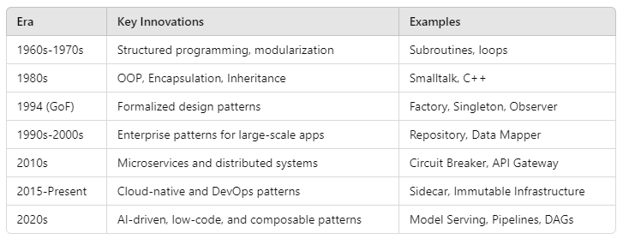
Evolution of Design Patterns

Slide 6
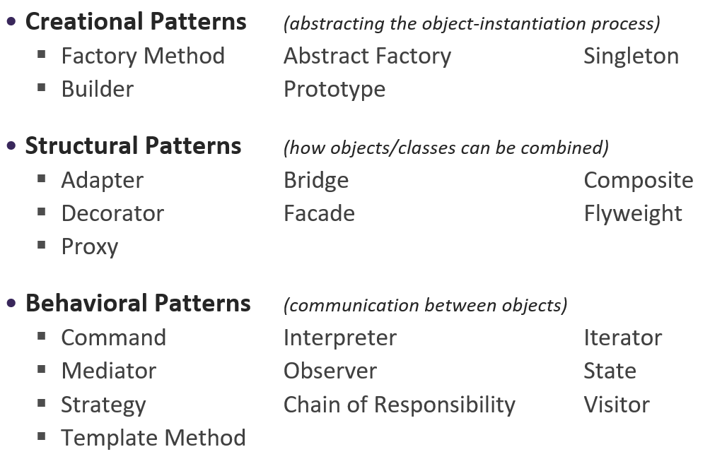
Types of Design Patterns
Creational Patterns: Deal with object creation mechanisms
Structural Patterns: Concerned with object composition
Behavioral Patterns: Characterize ways objects interact and distribute responsibility

Slide 7
Creational Patterns

Slide 8
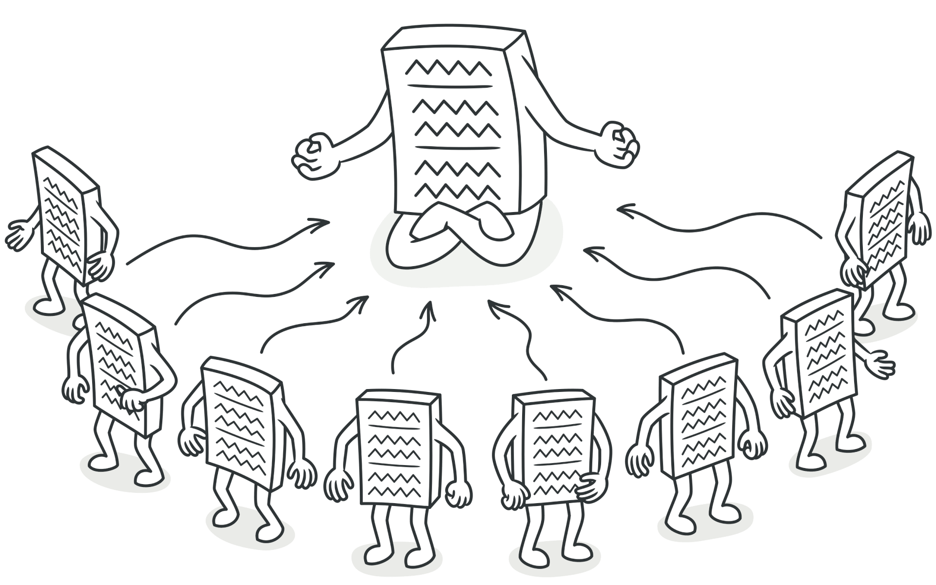
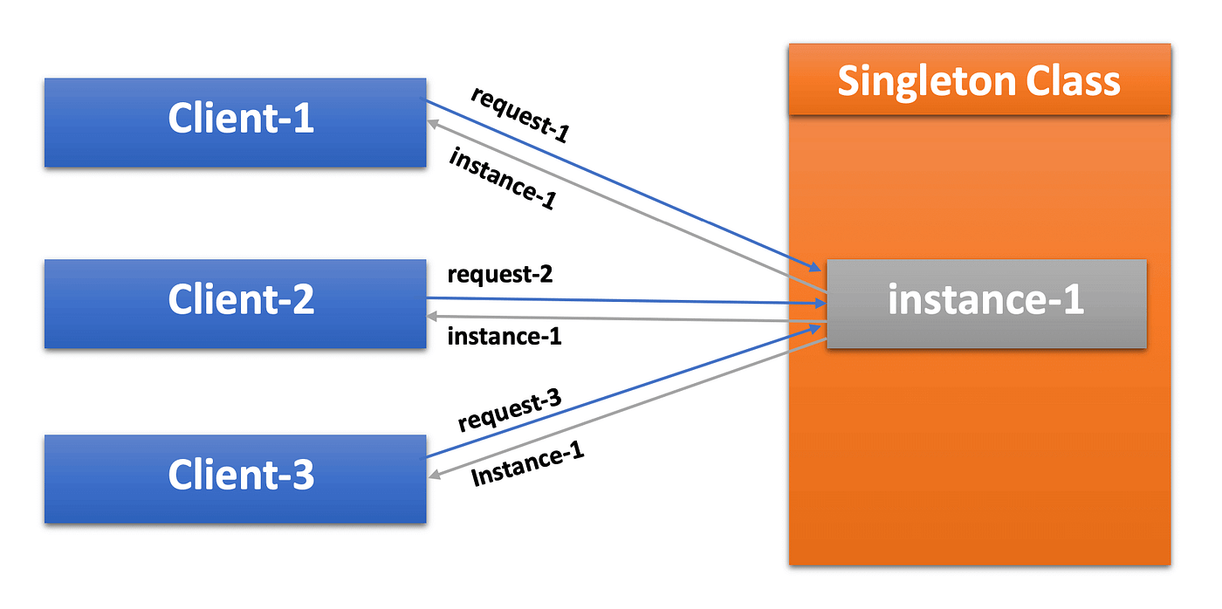
Singleton Pattern
Ensures a class has only one instance
Provides a global point of access to that instance
When to Use?
A single instance of a class is required throughout the application to manage shared resources or control access (e.g., logging, configuration settings, database connections).
Global access to that instance is needed, ensuring all parts of the application use the same instance and state.
Overuse can lead to hard-to-test, tightly-coupled, and error-prone code. Consider alternatives like Dependency Injection (DI) to avoid some of these drawbacks.

Slide 9
Singleton Pattern (Cont’d…)
class Singleton:
_instance = None
def __new__(cls):
if cls._instance is None:
cls._instance = super().__new__(cls)
return cls._instance
# Usage
s1 = Singleton()
s2 = Singleton()
print(s1 is s2) # True
Examples
Logger service: Ensures consistent logging across the application.
Configuration manager: Centralized access to application settings.
Database connection pool: Manages a single shared connection to the database.
Cache manager: Handles a global cache used by multiple modules.

Slide 10
Exercise
When would you use a Singleton?
What are potential drawbacks of using Singletons?

Slide 11
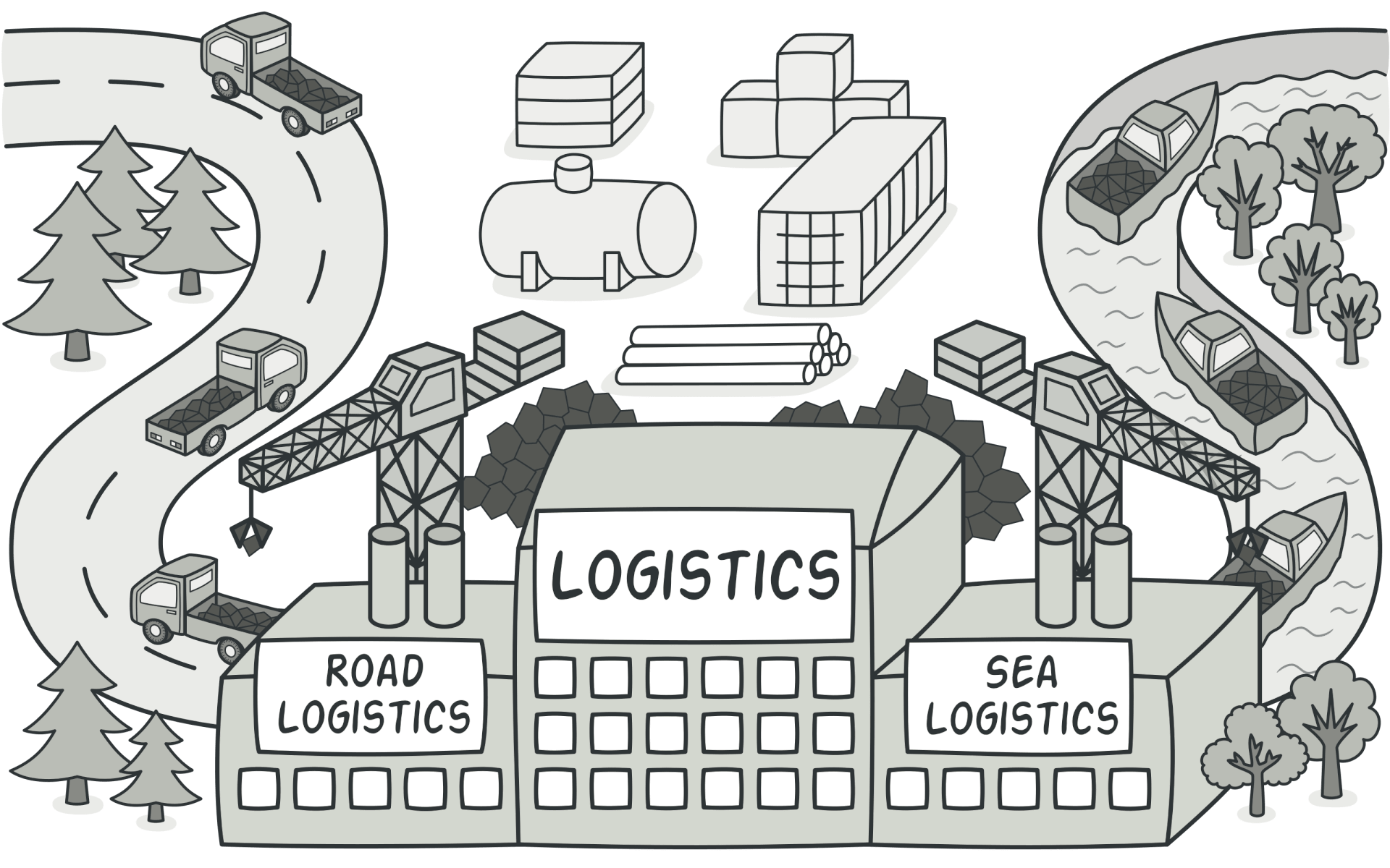
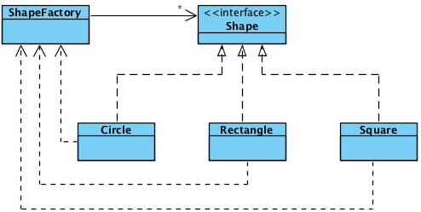
Factory Method Pattern
Defines an interface for creating an object
Lets subclasses decide which class to instantiate
When to Use?
You need to create objects without specifying their exact class.
You want to defer the instantiation logic to subclasses.
You want to follow the Open/Closed Principle (OCP).
You need to centralize object creation logic.
You want to ensure code maintainability and scalability

Slide 12
Factory Method Pattern (Cont’d…)
from abc import ABC, abstractmethod
class Animal(ABC):
@abstractmethod
def speak(self):
pass
class Dog(Animal):
def speak(self):
return "Woof!"
class Cat(Animal):
def speak(self):
return "Meow!"
class AnimalFactory:
def create_animal(self, animal_type):
if animal_type == "dog":
return Dog()
elif animal_type == "cat":
return Cat()
else:
raise ValueError("Unknown animal type")
# Usage
factory = AnimalFactory()
dog = factory.create_animal("dog")
print(dog.speak()) # Woof!
Examples
UI Components: Creating buttons, text fields, or windows for different platforms (e.g., Windows, Mac, Linux) using a common interface.
Database Connections: Instantiating database connections depending on the database type (e.g., MySQL, PostgreSQL, Oracle).
Parser Factory: Creating different file parsers (XML, JSON, CSV) based on the input file type.
Benefits
Promotes loose coupling by delegating object creation to subclasses.
Makes the code more extensible since new object types can be introduced without altering existing code.
Encourages better maintainability by centralizing complex object creation logic.

Slide 13
Exercise
Extend the AnimalFactory to include a new animal type (e.g., "cow"). Implement the new animal class and update the factory method.

Slide 14
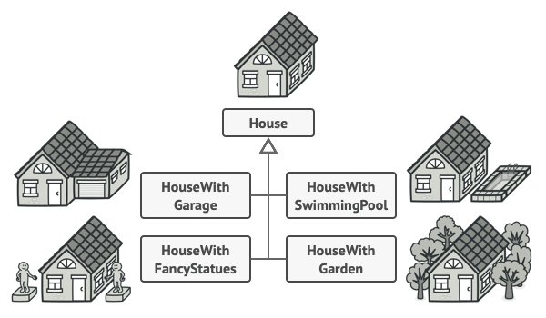
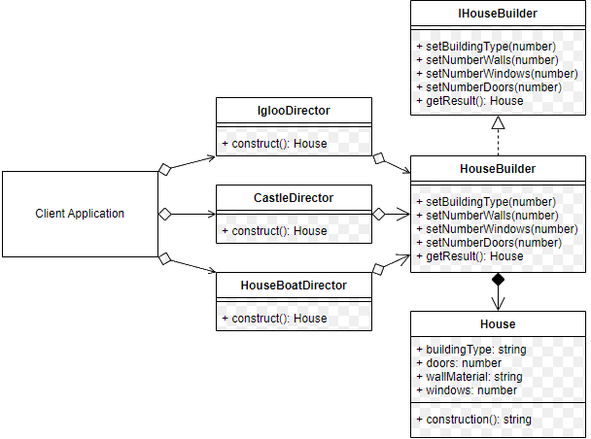
Builder Pattern
Allows the construction of complex objects step by step.
It provides greater control over object creation and lets you construct different representations of an object using the same building process.
When to Use?
Creating complex objects with many optional parts or configurations.
The creation process needs to be controlled step-by-step.
You need different variations of the same object.
Immutable objects are required (objects where changes after creation are not allowed).

Slide 15
Builder Pattern (Cont’d…)
// Builder Interface
public interface IMealBuilder {
void BuildMainDish();
void BuildSideDish();
void BuildDrink();
Meal GetMeal();
}
Create a Meal with various components (main dish, side, drink, and dessert).
// Director
public class MealDirector {
private IMealBuilder builder;
public MealDirector(IMealBuilder builder) {
this.builder = builder;
}
public void ConstructMeal() {
builder.BuildMainDish();
builder.BuildSideDish();
builder.BuildDrink();
}
}
// Concrete Builder
public class VegMealBuilder : IMealBuilder {
private Meal meal = new Meal();
public void BuildMainDish() => meal.MainDish = "Vegetable Curry";
public void BuildSideDish() => meal.SideDish = "Salad";
public void BuildDrink() => meal.Drink = "Juice";
public Meal GetMeal() => meal;
}
// Client Code
var vegMealBuilder = new VegMealBuilder();
var director = new MealDirector(vegMealBuilder);
director.ConstructMeal();
Meal vegMeal = vegMealBuilder.GetMeal();
Console.WriteLine($"Main Dish: {vegMeal.MainDish}, Side: {vegMeal.SideDish}, Drink: {vegMeal.Drink}");
// Product: Meal
public class Meal {
public string MainDish { get; set; }
public string SideDish { get; set; }
public string Drink { get; set; }
}
Concrete Builders:
VegMealBuilder: Builds a vegetarian meal.
NonVegMealBuilder: Builds a non-vegetarian meal.
Director:
Uses the builders to assemble the meal.
Example: "Make a full veg meal with salad and juice."

Slide 16
Exercise
Create a Pizza with different toppings, crusts, and sizes, where each configuration is built using the same process.

Slide 17
Structural Patterns

Slide 18
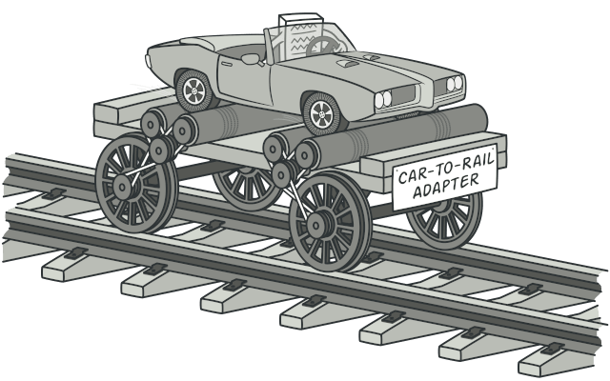
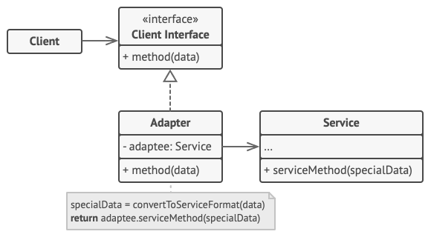
Adapter Pattern
Allows incompatible interfaces to work together
An adapter wraps one of the objects to hide the complexity of conversion happening behind the scenes.
When to Use?
you want to use some existing class, but its interface isn’t compatible with the rest of your code.
you want to reuse several existing subclasses that lack some common functionality that can’t be added to the superclass.

Slide 19
Adapter Pattern (Cont’d…)
class OldPrinter:
def print_old(self, text):
print(f"[Old Printer] {text}")
class NewPrinter:
def print_new(self, text):
print(f"[New Printer] {text}")
class PrinterAdapter:
def __init__(self, old_printer):
self.old_printer = old_printer
def print_new(self, text):
self.old_printer.print_old(text)
# Usage
old_printer = OldPrinter()
adapter = PrinterAdapter(old_printer)
adapter.print_new("Hello, World!") # [Old Printer] Hello, World!
Examples
Integrating Legacy Systems with Modern Applications.
Adapting External Libraries or APIs.
Connecting Different Data Formats (e.g., XML vs. JSON).
Connecting Different Protocols in Networking.
Supporting Multiple Database Drivers.

Slide 20
Group Discussion
Identify real-world examples of adapters in technology.
How does the Adapter pattern promote code reusability?

Slide 21
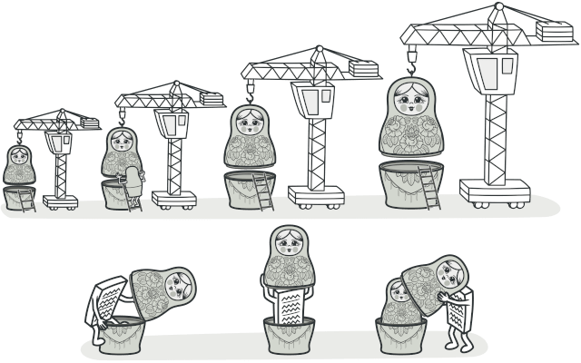
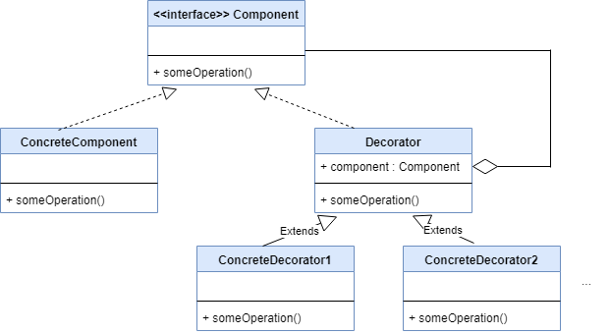
Decorator Pattern
Attaches additional responsibilities to an object dynamically
by placing these objects inside special wrapper objects that contain the behaviors.
When to Use?
You want to add behavior to objects dynamically at runtime.
You want to avoid subclass explosion caused by multiple features.
You need to extend the behavior of specific instances without affecting others.
You want to follow the Open/Closed Principle by adding new functionality without modifying existing code.
This pattern is powerful when behavior needs to be flexible, dynamic, and reusable across multiple objects.

Slide 22
Decorator Pattern (Cont’d…)
class Coffee:
def cost(self):
return 5
class MilkDecorator:
def __init__(self, coffee):
self._coffee = coffee
def cost(self):
return self._coffee.cost() + 2
class SugarDecorator:
def __init__(self, coffee):
self._coffee = coffee
def cost(self):
return self._coffee.cost() + 1
# Usage
coffee = Coffee()
milk_coffee = MilkDecorator(coffee)
sweet_milk_coffee = SugarDecorator(milk_coffee)
print(sweet_milk_coffee.cost()) # 8
Examples
I/O Streams: In Java, classes like BufferReader and InputStreamReader use decorators to add functionality such as buffering and reading character streams
Middleware in Web Frameworks: In web applications, middleware components (like authentication, logging, or rate limiting) can act as decorators by wrapping the request and adding functionality without changing the core application.
Coffee Order System: A basic coffee object can be decorated with add-ons like milk, sugar, or caramel. Instead of having multiple subclasses like CoffeeWithMilkAndSugar decorators allow flexibility in adding features.
When Not to Use the Decorator Pattern
If the decorators become too complex or the layers of decoration become difficult to manage.
If the behavior you need can be handled with inheritance or composition more effectively.
If there is no need for dynamic behavior changes at runtime.

Slide 23
Exercise
Extend the Coffee example to include more beverage types and decorators. Create a simple console application where users can "build" their drink and see the final cost.

Slide 24
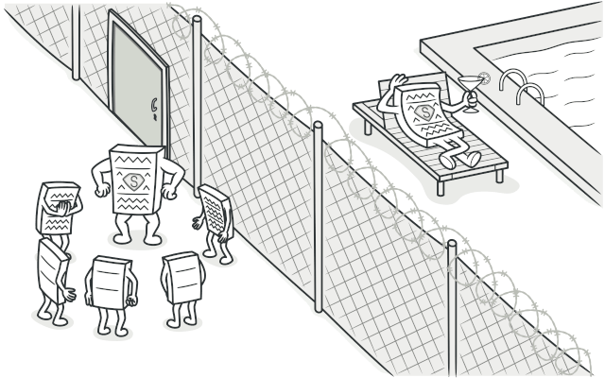
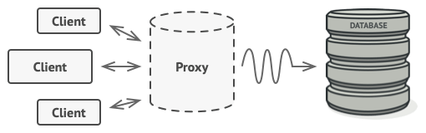
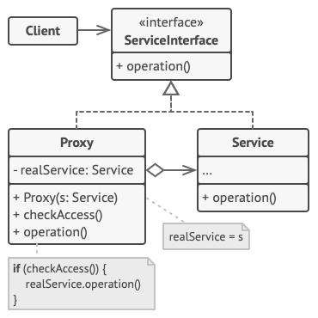
Proxy Pattern
Lets you provide a substitute or placeholder for another object.
A proxy controls access to the original object, allowing you to perform something either before or after the request gets through to the original object.
When to Use?
You need to control or restrict access to an object.
You want to delay object creation (lazy initialization).
You need to cache expensive operations.
The proxy acts as an intermediary, adding extra control or behavior while keeping the original object intact.

Slide 25
Proxy Pattern (Cont’d…)
class Document:
"""The Subject interface that defines the common operations."""
class RealDocument(Document):
"""The RealSubject class that contains the actual implementation."""
class DocumentProxy(Document):
"""The Proxy class that controls access to the RealDocument."""
# Client code
if __name__ == "__main__":
# Admin user trying to access the document
admin_document = DocumentProxy("admin", "This is a top secret document.")
admin_document.display()
print() # Adding a blank line for clarity
# Regular user trying to access the same document
user_document = DocumentProxy("user", "This is a top secret document.")
user_document.display()
Examples
Virtual Proxy: Loading images or videos on demand in a media application. The proxy only loads the content when it is viewed.
Remote Proxy: RMI (Remote Method Invocation) in Java, where a proxy object on the client side communicates with a remote object on a server.
Protection Proxy: In an enterprise system, access to certain critical resources (e.g., payroll information) is controlled through a proxy that checks user permissions.
When Not to Use the Proxy Pattern
If you don’t need control over access or additional functionality, using a proxy can add unnecessary complexity.
If performance is a critical concern, using a proxy might introduce some overhead (e.g., in remote proxies with network latency).

Slide 26
Behavioral Patterns

Slide 27
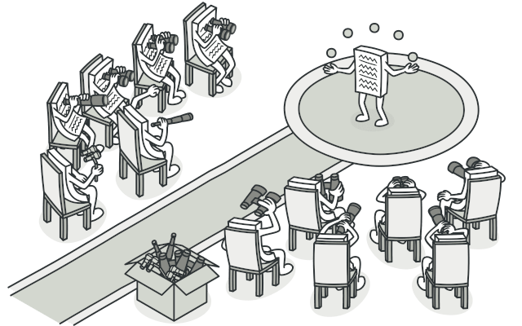
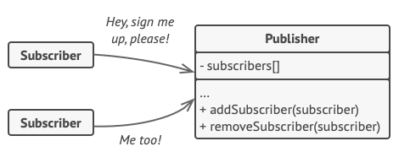
Observer Pattern
Defines a one-to-many dependency between objects.
Lets you define a subscription mechanism to notify multiple objects about any events that happen to the object they’re observing.
When to Use?
You need a one-to-many relationship between objects where a change in one triggers updates in others.
You want to promote loose coupling between the subject and its observers.
You are implementing features that require real-time data updates or event handling.
The Observer Pattern enhances the flexibility and reusability of your code while maintaining a clean separation of concerns.

Slide 28
Observer Pattern (Cont’d…)
class Subject:
def __init__(self):
self._observers = []
self._state = None
def attach(self, observer):
self._observers.append(observer)
def notify(self):
for observer in self._observers:
observer.update(self._state)
def set_state(self, state):
self._state = state
self.notify()
class Observer:
def update(self, state):
pass
class ConcreteObserver(Observer):
def update(self, state):
print(f"State changed to {state}")
# Usage
subject = Subject()
observer1 = ConcreteObserver()
observer2 = ConcreteObserver()
subject.attach(observer1)
subject.attach(observer2)
subject.set_state("New State")
Examples
Event Handling Systems: In GUI applications, user interactions like clicks, typing, or mouse movements often need to trigger updates in multiple components.
Real-Time Data Updates: Applications that display real-time data (like stock prices, news feeds, or weather updates) need to update multiple components when the data changes.
Game Development: In games, multiple objects often need to respond to the state changes of other objects (e.g., health changes, item pickups).
When Not to Use the Proxy Pattern
If the subject and observers are tightly coupled, the pattern may add unnecessary complexity.
If the observer count is very high, the performance may degrade due to the overhead of notifying all observers.
If observers have complex interdependencies, managing these relationships can become cumbersome.

Slide 29
Exercise - News Agency Simulation
Implement a simple news agency system using the Observer pattern. Create a NewsAgency (Subject) and multiple NewsChannels (Observers). Simulate breaking news scenarios.

Slide 30
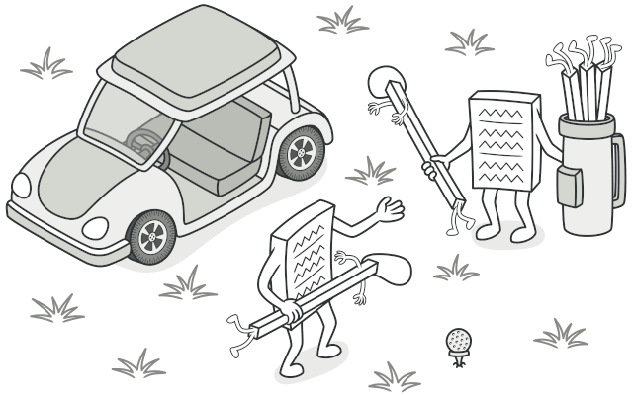
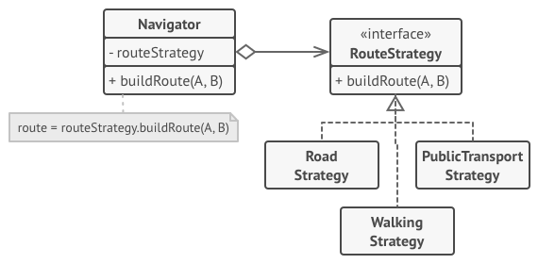
Strategy Pattern
Defines a family of algorithms, encapsulates each one, and makes them interchangeable.
When to Use?
you want to use different variants of an algorithm within an object and be able to switch from one algorithm to another during runtime.
you have a lot of similar classes that only differ in the way they execute some behavior.
to isolate the business logic of a class from the implementation details of algorithms that may not be as important in the context of that logic.

Slide 31
Strategy Pattern (Cont’d…)
from abc import ABC, abstractmethod
class PaymentStrategy(ABC):
@abstractmethod
def pay(self, amount):
pass
class CreditCardPayment(PaymentStrategy):
def pay(self, amount):
print(f"Paid ${amount} using Credit Card")
class PayPalPayment(PaymentStrategy):
def pay(self, amount):
print(f"Paid ${amount} using PayPal")
class ShoppingCart:
def __init__(self, payment_strategy):
self.payment_strategy = payment_strategy
def checkout(self, amount):
self.payment_strategy.pay(amount)
# Usage
cart = ShoppingCart(CreditCardPayment())
cart.checkout(100) # Paid $100 using Credit Card
cart.payment_strategy = PayPalPayment()
cart.checkout(200) # Paid $200 using PayPal
Examples
Sorting Strategies
Payment Methods
Compression Algorithms
This design pattern promotes the use of composition over inheritance and enhances the flexibility and maintainability of your code.

Slide 32
Exercise
Implement a new payment strategy (e.g., "CryptocurrencyPayment"). Then, create a simple console application that allows users to select a payment method and process a payment.

Slide 33
Anti Patterns

Slide 34
Anti Patterns
Patterns that seem like good solutions but lead to bad results
Examples:
God Object: A class that tries to do too much
Spaghetti Code: Unstructured and difficult to maintain
Golden Hammer: Trying to solve every problem with a familiar tool

Slide 35

Conclusion and Best Practices
Design patterns are tools, not rules
Use patterns to solve specific problems, not to show off
Understand the problem thoroughly before applying a pattern
Consider the trade-offs of using a particular pattern

Slide 36

Questions

Slide 37


